Slide 1
Drugs and Alcohol In The Workplace Walter Vieweg, DO, DPM, MA Lake County Safety Council October 18, 2019 Board Certified Occupational Medicine/Family Practice Medical Review Officer Lake Health Medical Director Occupational Medicine Civil Surgeon

Slide 2
Magnitude of the Problem
19.5 million Americans currently use illicit drugs
12.4 million of these are employed full time or part time
8.2 % of full time workers are current users
10.5% of part time workers are current users
20% of young adults (18-25 years old) currently use illicit drugs
75% of callers to the National Cocaine Helpline admit to having used drugs on the job

Slide 3
Denial
7.7 million people (3.3 % of the population) needed treatment for a diagnosable drug problem (excluding alcohol).
Only 1.4 million received treatment. 82% did not believe they needed treatment.

Slide 4
Effect on Employers
Worker’s Compensation Costs
Users have 50% higher worker’s comp costs
Users receive 10.5 times greater payments
Attrition
5.7% of users have changed jobs more than 3 times in the last year vs 2.3 % of non-users
Users are 77% more likely to be discharged within 3 years of hiring
Users have 47% higher rate of involuntary turnover

Slide 5
Attendance
11.6% of users have missed more than 2 days of work in the last month due to illness or injury vs 6.5% of non-users.
6.5% of users have skipped more than 2 days of work in the last month vs 4.4% of non-users
Users are absent from work 59% more frequently than non-users
Users are twice as likely to use excessive leave time
Users have a 3.5 times higher absenteeism rate

Slide 6
Impact
Productivity
Users have 33% lower productivity
64% report that drugs have adversely affected their job performance
Health Insurance
Users have 200% higher medical costs
Users have 8.5% times more medical claims
30% of those who sought treatment for illicit drugs problems last year had the costs covered by private health insurance (as opposed to public funds or personal savings)

Slide 7
Moral
44% admit to having sold drugs to fellow employees
18% say they have stolen from coworkers to pay for their drug habit

Slide 8
Testing Process
Review company policy and testing procedures. Document that you did this.
Do NOT allow the employee to drive on their own. A supervisor or manager must transport the employee to the testing facility. Arrange for transportation home as well.
The employee should not be left alone at the testing facility, nor should the employee ever be out of sight.
Company policy should address consequences if the employee refuses to take the test or if they cannot produce a sample.
Employees should be given notice of the test results and an opportunity to explain positive results with a medical review officer.
If the company allows a second test, should also be discussed.
Results will be reported to the designated employer representative.

Slide 9
Consequences of Failed Test
Return to Work
Last Chance Agreement
EAP Referral
Other Disciplinary Action
Leave
Transfer
Suspension
Termination
If employee returns to work, continue to monitor and document behaviors and other indicators.

Slide 10
If Results are Negative
Employee may have used an adulterant
Employee may not have had enough in their system for detection
Behavior may not be the result of drug use
Address performance issues and state expectations
Consider fitness for duty referral
Continue to monitor and document
Monitor other employees to minimize gossip and retaliation

Slide 11
Common Mistakes
Not consistently following and enforcing the company’s policy
Letting the employee drive on their own
Basing reasonable suspicion on hearsay
Inappropriate testing procedures
Failing to maintain confidentiality

Slide 12

Detection Periods for Drugs
THC (Marijuana)
1 Joint – 2 Days
3 Times /week – 2 Weeks
Daily – 3-6 Weeks
* Body fat has impact on duration

Slide 13
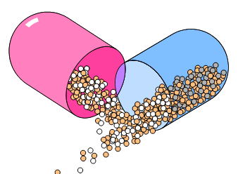
How Long Do Drugs Stay Detectable in urine
Amphetamine/Methamphetamine 48 hours
Barbiturates 24 hours
Cocaine 2-3 days
Codeine 48 hours
Marijuana 3 days (single use)
10 days (heavy user)
21-27 days (chronic heavy smoker)
Phencyclidine (PCP) 8 days

Slide 14
Drugs in The Workplace
The National Institute of Drug Abuse (NIDA) has identified the following drugs as the five drugs that are more commonly found in the workplace.
These are referred to as the “NIDA 5”
Alcohol, although not considered a drug, is also found in the workplace and is often the reason testing is ordered.

Slide 15
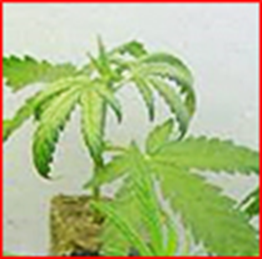
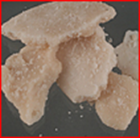
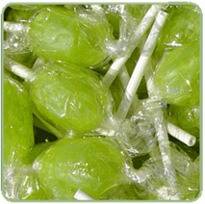
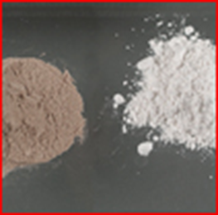
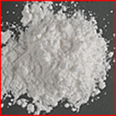
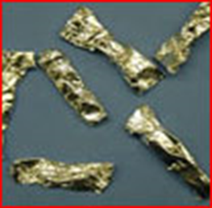
NIDA 5
Marijuana
Amphetamines/Methamphetamines
Opiates (Heroin)
Cocaine
Phencyclidine (PCP)

Slide 16
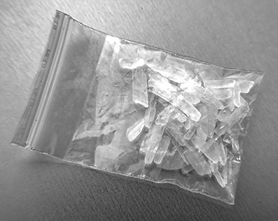
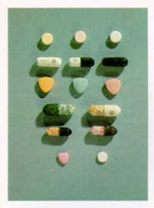
Methamphetamines
Street Names: Crank, Crystal, Speed
Looks Like: White powder, pills, rock resembling a block of paraffin
How Taken: Orally, injected, inhaled

Slide 17
Drug Facts – Amphetamine Methamphetamine
Discovered in 1920
Used as an Over the Counter (OTC) bronchial dilator
1937 found to reduce activity in hyperactive children
During WWII given to soldiers on both sides of the battle field to increase efficiencies
Weight loss

Slide 18
Methamphetamines
Manufactured in bathtubs, barns, motels, cars (driving down the road).
Highly explosive and contains material with a base of ephedrine (what Sudafed is made of)
Also contains many of these ingredients:
Red Phosphorous
Lighter Fluid
Drano
Acetone
Ether
Freon

Slide 19
Methamphetamines
Signs and Symptoms:
Edginess
Nervous
Restless
Hard to sit still
Twitching, jerking movements (loss of motor skills)
Itching, scratching (they feel like bugs are crawling on them)
Act very paranoid – feel people are out to get them and can make the individual very aggressive and violent
Sweat a lot – even when it is cold

Slide 20
Methamphetamines
Signs and Symptoms:
Rapid, irrational and slurred speech
Grinding their teeth
Runny nose
Sometime bloody nose for no reason
Sudden weight loss (no desire to eat)
Sickly looking
Skin sores on the arms and face
Rotten teeth and gums
Poor personal hygiene
Extreme/bizarre behavior

Slide 21
Methamphetamines
Long term effects of heavy use:
Depression
Permanent psychological problems
Possible brain damage
Disturbance of personality development
Liver damage
Fatal lung and kidney disorders
Stroke or heart problems
Death

Slide 22
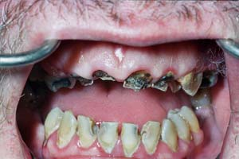
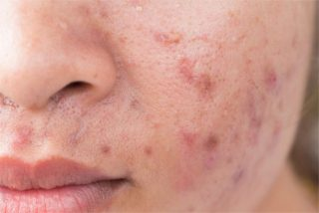
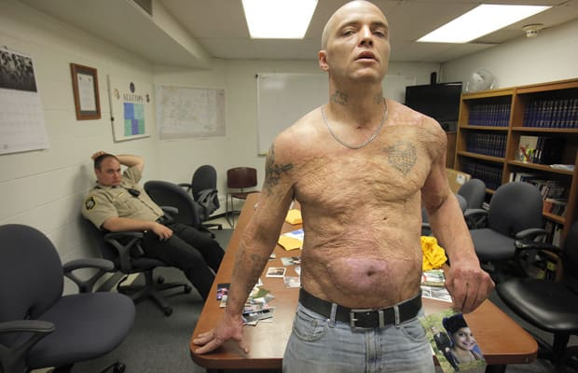
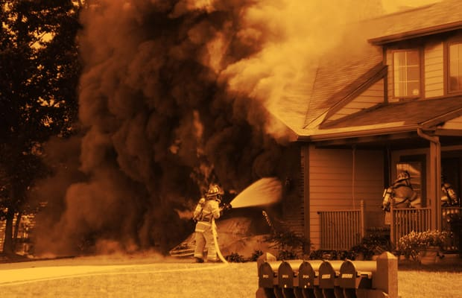
Methamphetamines
Meth mites
Meth mouth

Slide 23
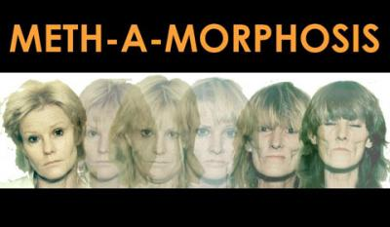
Methamphetamines

Slide 24
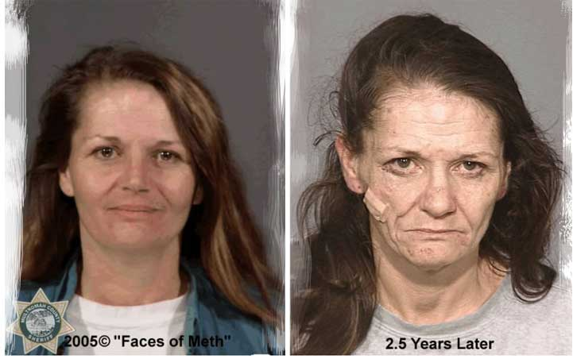
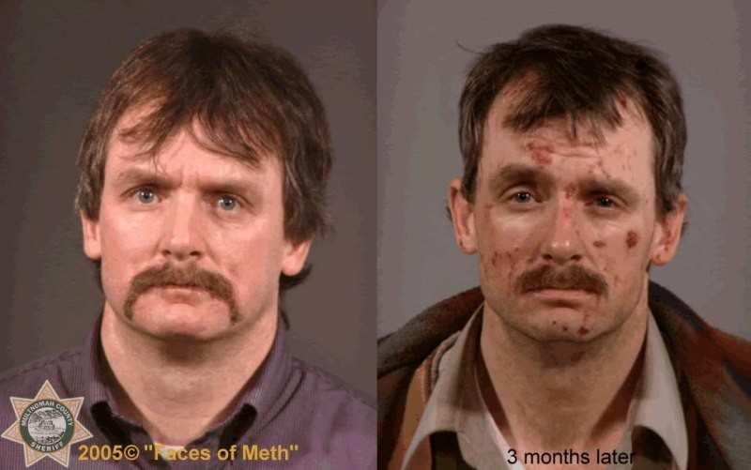
Results of Meth Use

Slide 25
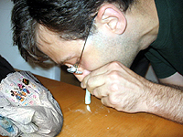
Cocaine
Street Names: Coke, Snow, Nose Candy, Flake, Blow, Big C, Lady, White, and Snowbirds
Looks Like: White crystalline powder
How Taken: Inhaled, injected

Slide 26
Drug Facts - Cocaine
From the coca plant, chewed for thousands of years
1916 coca cigarette “guaranteed to lift depression”
1886 used in tonic called Coca Cola – cure for all nervous afflictions
Until 1903, typical glass of coca cola contained 60 mg of cocaine

Slide 27
Cocaine
Effects
Produces brief but intense feelings of euphoria
Stimulates the central nervous system
Increases pulse, blood pressure, body temperature, and respiratory rate
Causes extreme excitability and anxiety
Produces sleeplessness and chronic fatigue
Dangers
Bleeding and damage to nasal passages
Paranoid psychosis, hallucinations and mental abnormalities
Impaired driving ability
Death caused by heart or respiratory failure

Slide 28
Cocaine
Addiction
Cocaine users often become psychologically and physically dependent on the drug after relatively short periods of time
In many cases, crack use leads to virtual immediate addiction
Withdrawal
Withdrawal symptoms from cocaine are not as physically apparent as with many other drugs
The most profound symptom is an intense craving for the drug once use is discontinued
If the craving is not satisfied, the individual may experience irritability, depression and a loss of energy

Slide 29
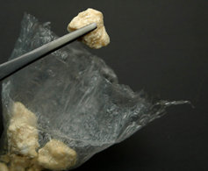
Crack Cocaine
Street Names: Crack, Rock, Freebase
Looks Like: Crystalline rocks that look like soap
How Taken: Smoked

Slide 30
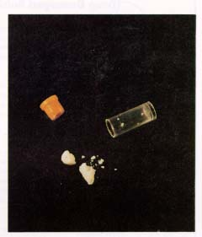
Crack Cocaine
The high from the first hit is so intense that the user will do almost anything to try to get that feeling again.
Many time this becomes a mission and everything else in life becomes secondary.
Will have no interest in doing any work, and may become violent for any reason.

Slide 31
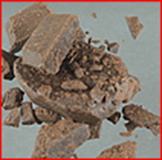
Marijuana
Street Names: Pot, Reefer, Grass, Weed, Dope, Ganja, Mary Jane, or Sinsemilla
Looks Like: Parsley, with stems and/or seeds; rolled into cigarettes or cigars
How Taken: Smoked or eaten in brownies, stew, and other goodies

Slide 32

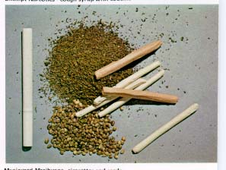
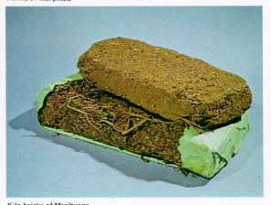
Marijuana

Slide 33
Drug Facts - Marijuana
It is going to change current company drug policies
Medical / Recreational / Safety Sensitive
Still illegal at Federal Level

Slide 34
Marijuana
Effects
Euphoric feeling: increased sense of well being
Lack of motivation
Lowered inhibitions, talkativeness
Dry mouth and throat
Increased appetite – “munchies”
Impaired coordination, concentration and memory
Increased heart rate
Dangers
Deteriorating performance at work
“Burn out” involving muddled thinking, acute frustration, depression, and isolation
Impaired sexual development and fertility
Damage to the lungs and pulmonary system (one joint is equal to 25 cigarettes
Hallucinations and paranoia
Increased risk to safety and health as a result of impaired judgment and motor abilities

Slide 35
Marijuana
“I was at a concert next to some people who were smoking some marijuana and I inhaled enough of the smoke and that made me test positive”.
While it is possible to produce levels of marijuana in a urine sample, cutoff levels were established in order to disallow a claim of passive inhalation.
To exceed the cutoff levels established by the United States Department of Health and Human Services, the individual would have to use marijuana in some manner (e.g. smoke, eat in food, etc.)

Slide 36
Medical Marijuana in the Workplace
On September 8, 2016, the State of Ohio approved House Bill 523 which legalized marijuana for medical use
The State Medical Board of Ohio is responsible for certifying licensed physicians who will be able to prescribe it.
Currently, there are 56 certified dispensaries in Ohio
To qualify, your prescription will be just for one year but you can only purchase one 90-day supply at a time.

Slide 37
Medical Marijuana in the Workplace
In order to qualify for medical marijuana you need to be diagnosed with one of the following diseases:
Aids
Amyotrophic Lateral Sclerosis
Alzheimer’s disease
Cancer
Chronic traumatic encephalopathy
Crohn’s disease
Epilepsy or another seizure disorder
Fibromyalgia
Glaucoma
Hepatitis C
Inflammatory bowel disease
Multiple sclerosis
Pain that is either chronic and severe or intractable
Parkinson’s disease
Positive status for HIV
Post-Traumatic stress disorder
Sickle cell anemia
Spinal Cord disease or injury
Tourette’s syndrome
Traumatic brain injury
Ulcerative colitis

Slide 38
Medical Marijuana
Also, employers retain the right to take adverse action against employees and applicants who use, possess or distribute medical marijuana.
Area of concern: If an employer prohibits employees from the use of prescribed medical marijuana, are they in violation of the American with Disabilities Act (ADA).
ADA prohibits employers from discriminating against qualified individuals on the basis of a disability and requires them to provide reasonable accommodation.
Due to the fact that Medical Marijuana is generally prescribed to individuals who have medical conditions recognized under ADA that need to allow accommodation (seizures), do we need to accommodate for it’s use?

Slide 39
Medical Marijuana
Because under FEDERAL law, marijuana remains a prohibitive schedule I substance which is illegal, courts have generally found that employers are not required to accommodate for the use of medical marijuana under ADA. BE CAREFUL!
EMPLOYER’S RESPONSBILITIES
Develop and review policies based upon state regulations and initiate updates where appropriate.
Review and designate job descriptions related to safety sensitive positions.
Communicate and document discussions with employees regarding drug screening and consequences of drug use as it relates to their job.
Continue to obtain legal advise regarding ever changing ADA regulations.
Treat all employees the same.

Slide 40
Cannabidiol (CBD)
Primary component of cannabis. We know most about the oil form.
85 compounds in cannabis plant.
CBD and THC most prominent
CBD will not get you high
CBD has many natural benefits for the following conditions:
Pain Diabetes
Epilepsy Nausea
Multiple Sclerosis Arthritis
Amyotrophic Lateral Sclerosis (ALS) Migraines
Parkinson’s PTSD
Acne Autim
Psoriasis
Depression
Bacterial Infection

Slide 41
CBD FACTS
CBD oil can come from both marijuana and hemp
Hemp CBD usually has such low levels of THC they are unlikely to produce a positive THC test
Ohio just passed a bill allowing cultivation and sale of CBD products derived from hemp. These products must not contain > 0.3% THC.
CBD products with >0.3% THC must be obtain via the medical marijuana process.
In order for a CBD product with <0.3% THC to test positive, one would have to consume 1000-2000 mg of the product.
Advice to employees: If you are unsure of the hemp product you want to use, “DON’T TAKE IT”

Slide 42
CBD Video
https://m.youtube.com/watch?v=5kNQ3m3J7Xc

Slide 43
OPIOID FACTS
From 1999-2017 more than 700,000 people in the US have died from a drug overdose.
In 2017, more than 70,200 drug overdose death occurred due to an opioid.
On average, 130 Americans die every day from an opioid overdose. Death involve both men and women, all races and all ages.
Opioids bind to areas of the brain that control pain and emotions. They drive up dopamine and produce intense euphoria.
The major cause of our opioid epidemic is most likely due to legal pain killers like Oxycodone and Hydrocodone prescribed by physician.

Slide 44
Drug Facts - Opiates
Not a new problem.
In the mid-1800s multiple medications contained opiates causing an epidemic and the creation of the first Food and Drug law

Slide 45
Heroin (Opiates)
Street Names: Smack, Horse, Mud, Brown Sugar, Junk, Black tar, Big H
Looks Like: White to dark-brown powder or tar like substance
How Taken: Injected, smoked or inhaled

Slide 46
Heroin (Opiates)
Effects:
The physical effects of opiates depends on the opiate used, the dose, and how the drug is taken. Effects may include:
Short lived state of euphoria, followed by drowsiness
Slowed heart rate, breathing, and brain activity
Depressed appetite, thirst, reflexes and sexual desire
Dangers:
AIDS, blood poisoning, and hepatitis as the result of drug infection and use of unsterilized or “shared” needles
Death resulting from the injection of impure heroin
Death resulting from unexpectedly high purity of drug
Convulsion, coma, or death from overdose

Slide 47
Heroin (Opiates)
Addiction:
Opiates, particularly heroin, have an unusually high potential for abuse and addiction. Heroin addiction often leads to malnutrition, infection, and unattended injuries and diseases.
Addicts tend to continue using the drug despite damaging physical and psychological consequences
Withdrawal
Following long-time or heavy use, withdrawal symptoms generally appear 4-8 hours after the last dose. Symptoms include chills, irritability, insomnia, and tremors. These symptoms are usually worse 24-72 hours after onset, and can last from 7-10 days.

Slide 48
Heroin (Opiates)
“I had poppy seed muffins at breakfast before I went to take the drug test and the next thing I know the doctor informed me I had failed the test”.
Much like marijuana, eating poppy seed muffins may produce a positive test in the urine sample. However, the cutoff levels are set at a level designed to eliminate this claim.
An individual would not be able to consume enough muffins to exceed the cutoff levels established by the United States Department of Health and Human Services.

Slide 49
Fentanyl
Fentanyl is a powerful synthetic opioid analgesic that is similar to morphine but is 50 to 100 times more potent. Prescribed for post surgical pain.
59% of all opioids related deaths are related to Fentanyl
Powder, dropped on blotter paper like candies, in eye droppers or nasal sprays or made into pills that look like real prescription opioids.
Illegal fentanyl is mixed with other illegal drugs
Fentanyl works by binding to the body’s opioid receptors. It effects include extreme happiness, drowsiness, nausea, confusion, constipation, sedation, tolerance, addiction, respiratory depression, and arrest, unconsciousness, coma, and death.

Slide 50
Fentanyl
The high potency of fentanyl greatly increases risk of overdose, especially if a person who uses drugs is unaware that a powder or pill contains it.
They can underestimate the dose of opioids they are taking, resulting in overdose.
Naloxone is a medicine that can be given to a person to reverse a fentanyl overdose. Multiple naloxone doses might be necessary because of fentanyl’s potency.

Slide 51

Carfentanil or Carfentanyl
Synthetic opioid
100 x more potent than Fentanyl
10,000 x more potent than Morphine
Used to sedate elephants
So potent that when veterinarians handle it, they must wear protective gear, so as to not breath it in or absorb it through their skin.

Slide 52
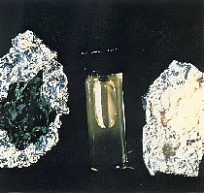
PCP - Phencyclidine
Street Names: Angel dust, ozone, whack, rocket fuel, hog, love boat
Looks Like: Liquid, white crystalline powder, pills, capsules
How Taken: Orally, injected, smoked (sprayed on joints or cigarettes

Slide 53
Drug Facts - Phencyclidine
Angel Dust
1957 first use as an anesthetic drug
Soon found patients had psychotic reaction to it
Now, used to lace marijuana to increase it’s effectiveness

Slide 54
PCP
The effects of PCP are:
Altered states of consciousness
Disorientation, confusion, and memory loss;
Highly unpredictable, and bizarre or violent behavior;
Extreme agitation;
Impaired driving ability; and
Increase tolerance for pain

Slide 55
PCP
Physical dependence on PCP has been documented and may be accompanied by memory loss, violence, weight loss, and paranoia. Symptoms of withdrawal include headaches, intense craving for the drug, increased need for sleep, and “flashbacks” for a period of years.
Even short term use can be dangerous causing mental changes resembling schizophrenia, severe depression, loss of learning abilities, and violent and other “intoxicated” behaviors resulting in bodily harm or death.

Slide 56
Drug Facts - MDMA
Psychedelic Hallucinogen
Top most party drug in the USA.
First invented by Merck as appetite suppressant.
Can be used orally for quick effect known anal “plugging”

Slide 57
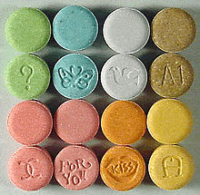
Ectasy MDA MDEA
Stimulant
Hallucinogenic Designer Drugs
Amphetamines like rush that last 20-40 minutes
When combined with physical activity such as dancing, it can lead to hyperthermia, dehydration, increased blood pressure, stroke and death.
Popular at “RAVE” parties

Slide 58
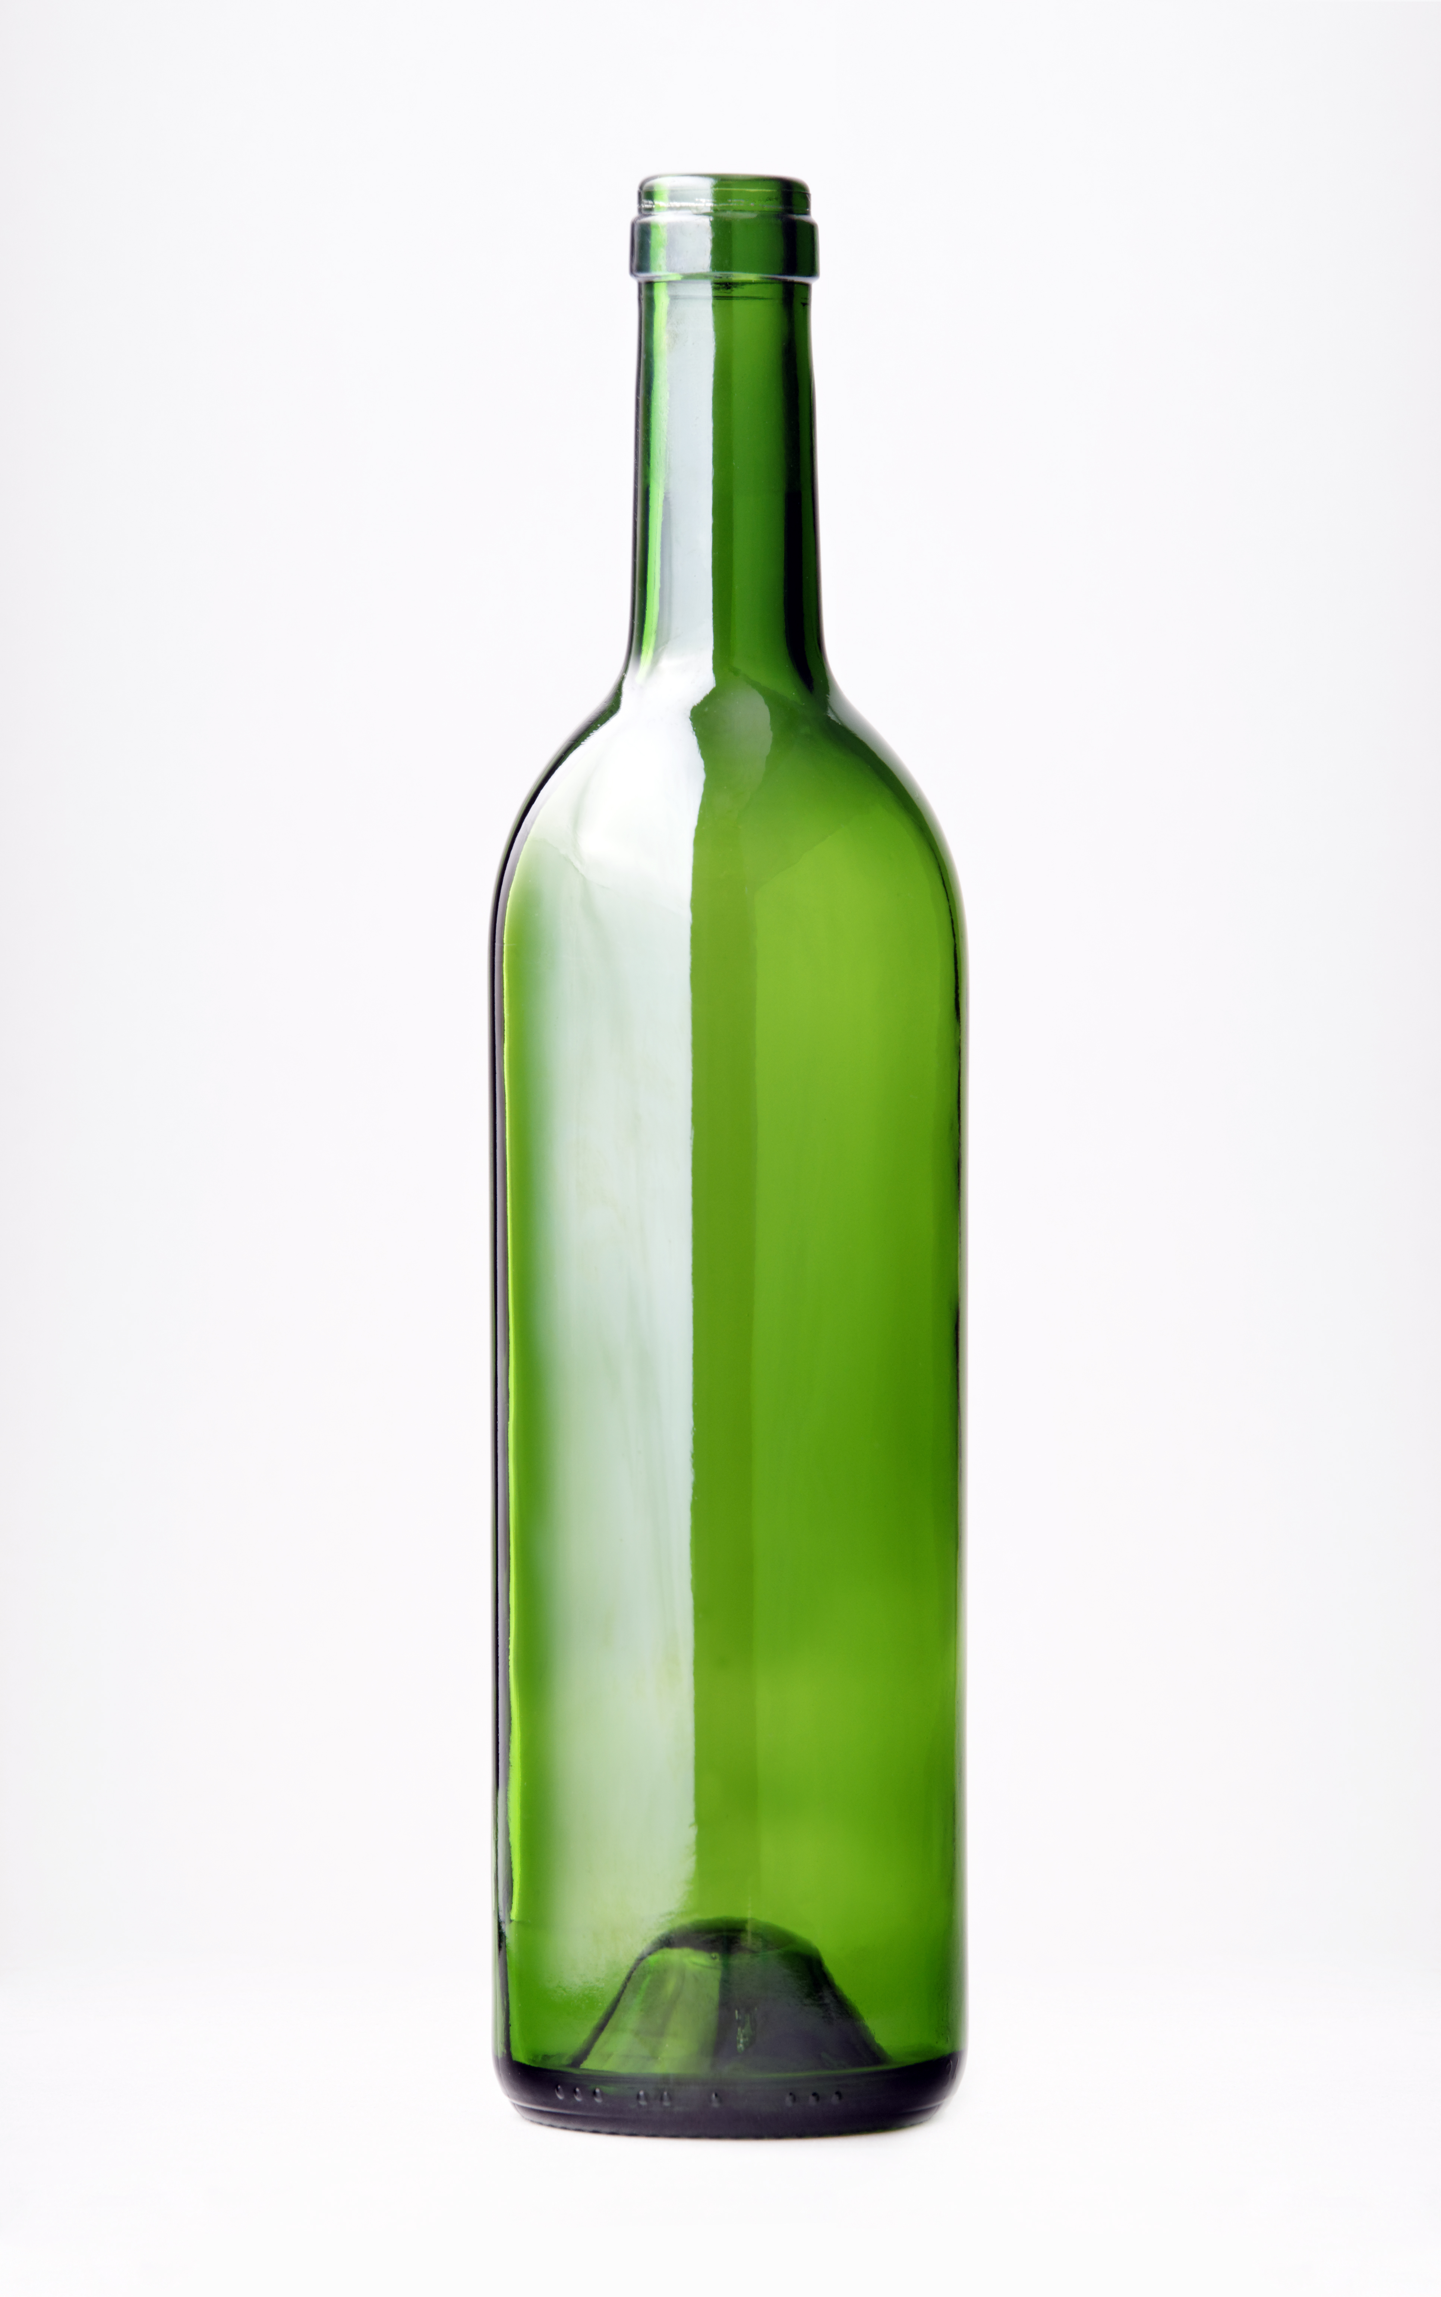
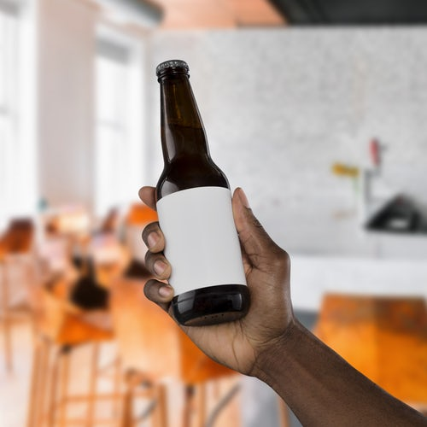
Alcohol
Prolonged heavy use can lead to:
Isolation from family and friends
Difficulty handling daily problems
Learning and memory problems (users may remember less than those who don’t use alcohol)
Depression
“Blackouts” – users may forget whole blocks of time (and what they did or said)

Slide 59
Alcohol
One drink can affect the:
Body
Alcohol enters the bloodstream almost instantly
It travels to the brain and all the body organs
It depresses the central nervous system and impairs:
thinking and reflexes
balance and coordination
vision
Mind
In small doses, it can impair judgement, leading to risk choices such as driving under the influence
In larger doses, users may feel confused and moody. Strong feelings such as anger, jealously and depression, can quickly lead to loss of self control
Increasing the dose even more can cause alcohol poisoning, unconsciousness, coma, even death

Slide 60
Immediate Effects of Alcohol
Odor on breath
Initial stimulation, followed by depressed nervous system
Flushed skin
Glazed appearance of the eyes
Slowed reaction time
Impaired motor skills
Difficulty focusing

Slide 61
Alcohol
Stays in the body for up to 24 hours
Effects: Blood Alcohol Concentration = BAC
Body processes .015 BAC per hour
BAC = 0.10 Simple reactions, such as braking are 11% slower
BAC = 0.15 Complex reactions, such as braking, steering and shifting are 41% slower
BAC = 0.5 Usually fatal

Slide 62

Blood Alcohol Levels
.02 Mellow feeling, less inhibited, body warmth
.05 Noticeable relaxation, impaired coordination
.08 Limit for DUI, impaired judgement
.10 Noisy, embarrassing behavior, mood swings
.15 Impaired balance, clearly drunk
.30 Many pass out
.40 Most pass out, some die
.50 Breathing stops, many die

Slide 63
Blood Alcohol Levels Men
Approximate Blood Alcohol Levels for MEN
Drinks | 100 lbs | 120 lbs | 140 lbs | 160 lbs | 180 lbs | 200 lbs | 220 lbs | 240 lbs | Physical and Mental Impairments
1 | 0.05 | 0.04 | 0.03 | 0.03 | 0.03 | 0.02 | 0.02 | 0.02 | Thought, concentration, coordination and judgment affected
2 | 0.07 | 0.06 | 0.05 | 0.05 | 0.04 | 0.04 | 0.03 | 0.03
3 | 0.11 | 0.09 | 0.08 | 0.07 | 0.06 | 0.06 | 0.05 | 0.05 | Reflexes, reasoning, depth perception, and peripheral vision impaired
4 | 0.14 | 0.12 | 0.11 | 0.09 | 0.08 | 0.08 | 0.07 | 0.06
5 | 0.18 | 0.16 | 0.13 | 0.12 | 0.11 | 0.09 | 0.09 | 0.08
6 | 0.22 | 0.19 | 0.16 | 0.14 | 0.13 | 0.11 | 0.1 | 0.09 | Coordination and judgment very impaired; slurred speech, staggering
7 | 0.26 | 0.22 | 0.19 | 0.16 | 0.14 | 0.13 | 0.11 | 0.1
8 | 0.29 | 0.25 | 0.21 | 0.19 | 0.17 | 0.15 | 0.14 | 0.13
9 | 0.34 | 0.28 | 0.24 | 0.21 | 0.19 | 0.17 | 0.15 | 0.14 | Severe motor impairment, loss of consciousness, memory blackout
10 | 0.37 | 0.21 | 0.26 | 0.23 | 0.2 | 0.18 | 0.17 | 0.15
11 | 0.4 | 0.34 | 0.28 | 0.25 | 0.22 | 0.19 | 0.18 | 0.16
12 | 0.44 | 0.37 | 0.31 | 0.27 | 0.24 | 0.21 | 0.2 | 0.18 | Dangerous level of intoxication

Slide 64
Blood Alcohol Levels Women
Approximate Blood Alcohol Levels for WOMEN*
Drinks | 100 lbs | 120 lbs | 140 lbs | 160 lbs | 180 lbs | 200 lbs | 220 lbs | 240 lbs | Physical and Mental Impairments
1 | 0.05 | 0.04 | 0.03 | 0.03 | 0.03 | 0.02 | 0.02 | 0.02 | Thought, concentration, coordination and judgment affected
2 | 0.09 | 0.08 | 0.07 | 0.06 | 0.05 | 0.05 | 0.04 | 0.04
3 | 0.14 | 0.11 | 0.1 | 0.09 | 0.08 | 0.07 | 0.06 | 0.06 | Reflexes, reasoning, depth perception, and peripheral vision impaired
4 | 0.18 | 0.14 | 0.12 | 0.11 | 0.1 | 0.08 | 0.08 | 0.07
5 | 0.22 | 0.18 | 0.16 | 0.14 | 0.12 | 0.11 | 0.09 | 0.09
6 | 0.27 | 0.22 | 0.19 | 0.17 | 0.15 | 0.13 | 0.12 | 0.1 | Coordination and judgment very impaired; slurred speech, staggering
7 | 0.31 | 0.26 | 0.22 | 0.19 | 0.17 | 0.15 | 0.14 | 0.12
8 | 0.36 | 0.29 | 0.25 | 0.22 | 0.2 | 0.17 | 0.16 | 0.14
9 | 0.4 | 0.33 | 0.29 | 0.25 | 0.22 | 0.19 | 0.18 | 0.16 | Severe motor impairment, loss of consciousness, memory blackout
10 | 0.45 | 0.37 | 0.32 | 0.28 | 0.25 | 0.22 | 0.2 | 0.18
11 | 0.49 | 0.42 | 0.35 | 0.3 | 0.27 | 0.24 | 0.22 | 0.19
12 | 0.54 | 0.44 | 0.38 | 0.33 | 0.3 | 0.26 | 0.24 | 0.21 | Dangerous level of intoxication
* Subtract approximately .015 for every hour
One drink = 1.25 oz. of 80 proof liquor, 12 oz beer, 5 oz. wine

Slide 65
So what if I went out last night!
2:00 AM – Go to bed with BAC of .19
4:00 AM – Sleeping with BAC of .16
6:00 AM – Get up for work with BAC of .13
7:00 AM – Leaving home with BAC of .115
8:00 AM – At work with BAC of .10
9:00 AM – Spills coffee with BAC of .085
10:00 AM – Still impaired at .07
12:00 Noon – Still impaired at .055

Slide 66
Inhalants
Volatile Solvents
Thinners, removers, cleaning fluids, gas (benzene, toluene), glues, correction fluid, felt markers
Aerosols (propellants contain solvents)
Spray paints, deodorants, cooking sprays, fabric sprays
Gases (i.e. medical gases)
Ether, chloroform, nitrous oxide (whipped cream can), butane lighters, refrigerants (Freon)
Nitrates (work by dilating blood vessels/relax muscles)
Cyclohexyl nitrite, isobutyl nitrite, amyl nitrite (video head cleaner, room deodorizer, leather cleaner, liquid aroma)
Used to enhance sexual experience

Slide 67
Inhalants
Signs
Chemical odors on breathing /clothing
Paint/stains on face/hands/cloths
Hidden empty containers/soaked rags
Drunk/disoriented appearance
Slurred speech
Nausea or loss of appetite
Inattentiveness, lack of coordination, irritability, depression

Slide 68
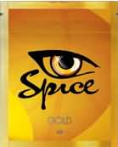
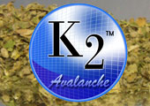
Other Drugs of Concern
Synthetic Marijuana (K2, Spice, Serenity, Genie, Hush, etc)
Ingredient (JWH) impacts cannabinoid receptors
Dry mouth, light headed, blurred vision, agitation, restlessness, normal pupils, perceptual changes, time distortion, mild anxiety/paranoia, sedation, exhaustion
Up to 4 times more powerful than marijuana
March 1, 2011, DEA banned possession and distribution

Slide 69
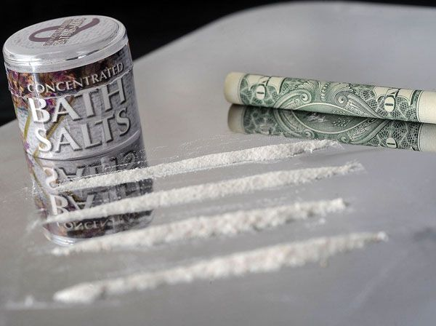
Other Drugs of Concern
Synthetic Stimulants (Bath Salts, Plant Food, Ivory Wave, Red Dove, Blue Silk, Cloud Nine, and etc)
Active Ingredients vary: MPDV, Mephedrone, Pyrovalerone
Cocaine/Meth-like effect including aggression, paranoia, suicide
Intense cravings, high risk of overdose – increased Emergency Department visits – deaths reported in the US and Europe
White House has issued Emergency Department alerts – Legislations to ban in multiple states

Slide 70
Drug Abuse and Mental Illness – Be Careful
Signs of drug use similar to symptoms of mental illness
Depression
Irritable, angry, sad, anergia, amotivation, anhedonia, problems concentrating, hopelessness
Mania
Racing mind/speech, irritable, suphoria, grandeur, many started projects, spending
Mental Illness
Psychotic Disorder
Audio/visual hallucinations, flat affect, depression
Anxiety
Irritability, fearful, avoidance, panic symptoms, agoraphobia
American with Disabilities Act (ADA)
Covers Chemical Dependency/Abuse
Does not cover if test positive

Slide 71
Thank you! Walter Vieweg, DO

